Slide 1
Dataset
  Chest X-ray images :
    Training set- {covid: 460,normal: 1266 , pneumonia: 3418 }
    Test set – {covid: 116,normal: 317, pneumonia: 855}

Slide 2
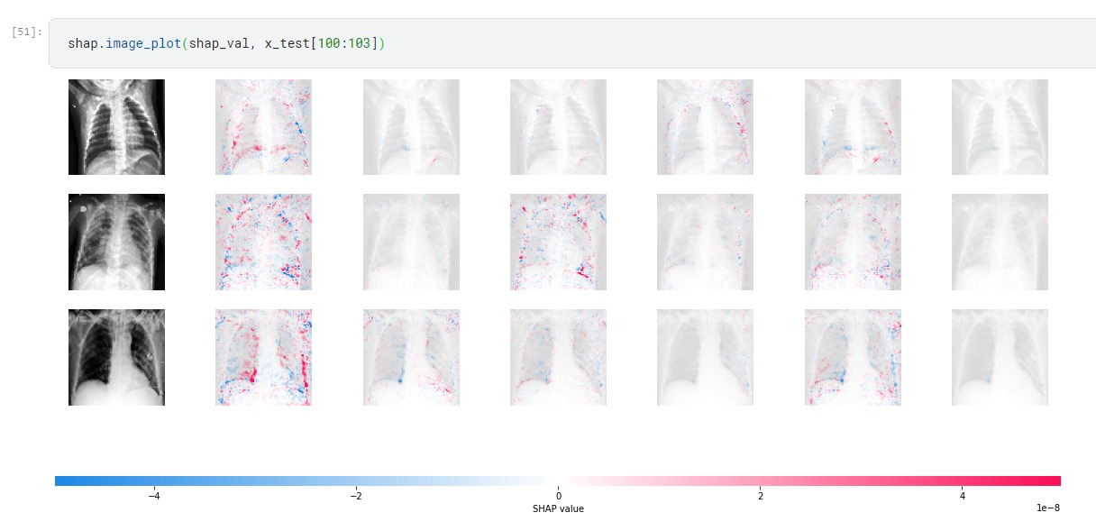
Shap values –try out on RestNet50 model prediction
Need to fine tune results**

Slide 3
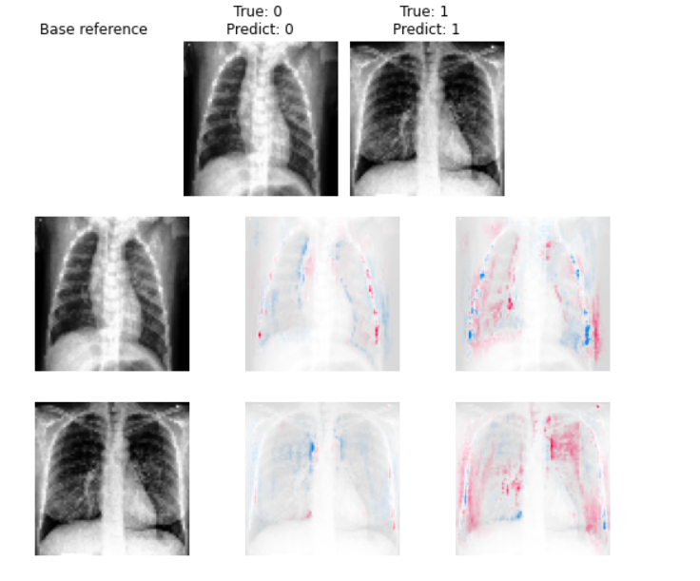
Shap for CNN without resampling
Red - positive influence on classification
Blue – negative influence on classification
Non covid
covid

Slide 4
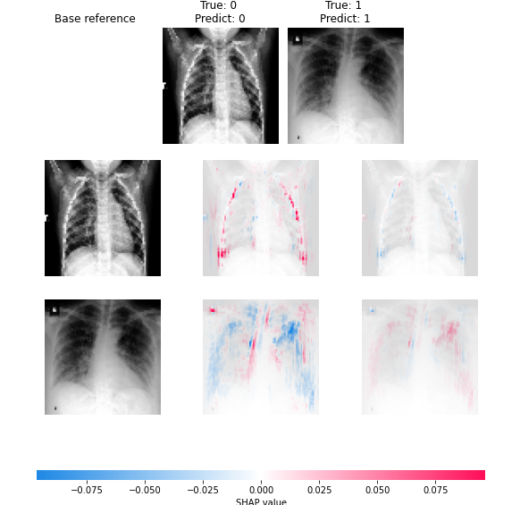
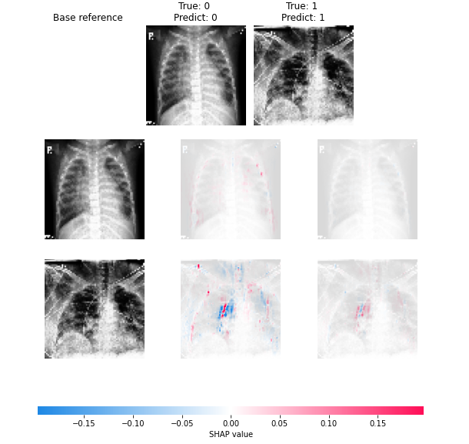
Shap for CNN with resampling
oversampling
undersampling

Slide 5
Progress
CNN, ResNet50 without resampling – done
CNN, ResNet50 with resampling(oversampling and under sampling) – done
VGG-16 – (resolving a problem in model fitting)
Shapley values on models – CNN(done), ResNet50(done), VGG-16 (in progress)

Slide 6
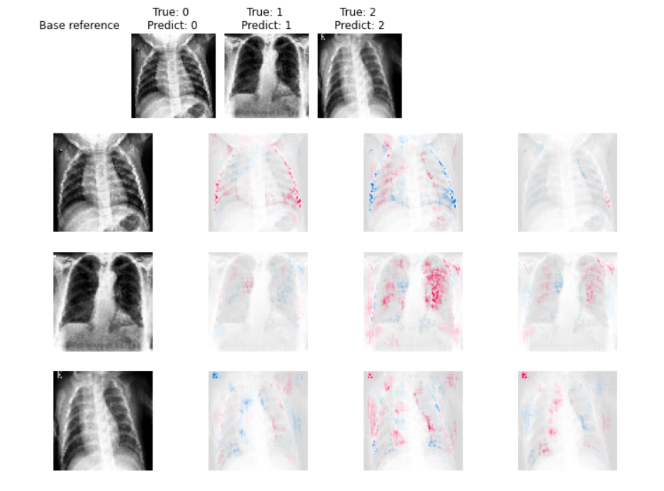
CNN without resampling
Normal (0)
Covid19 (1)
Posterior and peripheral
Pneumonia (2)
Central and peripheral diffusion
Notes:
Red pixels represent positive SHAP values that contributed to classifying that image as that particular class.
Blue pixels represent negative SHAP values that contributed to not classifying that image as that particular class.

Slide 7
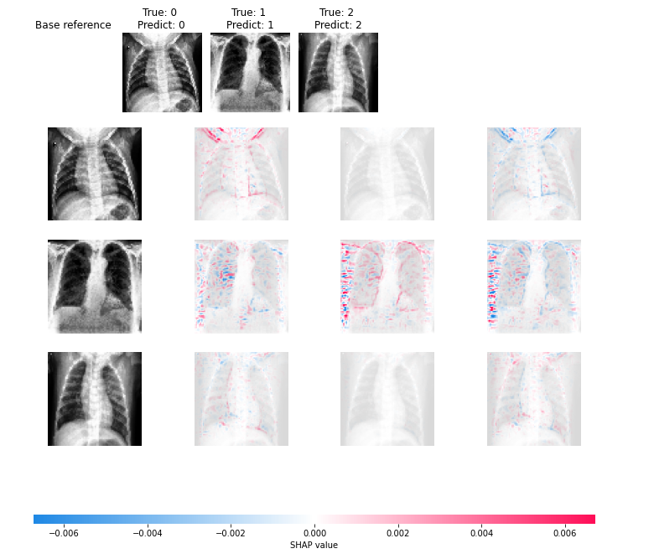
VGG 16

Slide 8
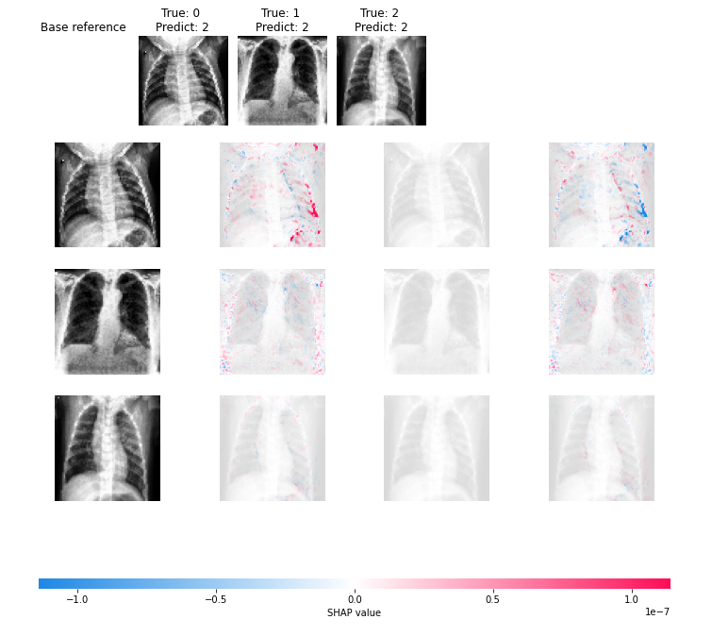
Resnet 50

Slide 9
Clinical features covid19 vs pneumonia
The difference in the number of involved pulmonary lobes observed on CT and pulmonary fields observed on radiographic images was significantly higher in COVID-19-associated pneumonia than that in influenza-associated pneumonia. (Kör, H., Erbay, H. & Yurttakal, 2022)
Both infections commonly involve multiple lobes bilaterally, GGOs were more common in patents with COVID-19, while consolidations were more common in H1N1.
In COVID-19, mainly peripheral and posterior zones were involved, whereas in H1N1 pneumonia, the pattern of involvement was more diffuse with both central and peripheral involvement. It is noteworthy that in the advanced stage of COVID 19 infection, the imaging findings become non-specific and indistinguishable from other pneumonias. (Eslambolchi A, Maliglig A, Gupta A, Gholamrezanezhad,2020)

Slide 10
Progress
CNN, ResNet50, VGG16 without resampling – done
CNN, ResNet50, VGG16 with resampling(oversampling and under sampling) – done
Shapley values on models – CNN(done), VGG-16 (done)
ResNet50 - issue with prediction classes after converting into 3 way classification

